Slide 1

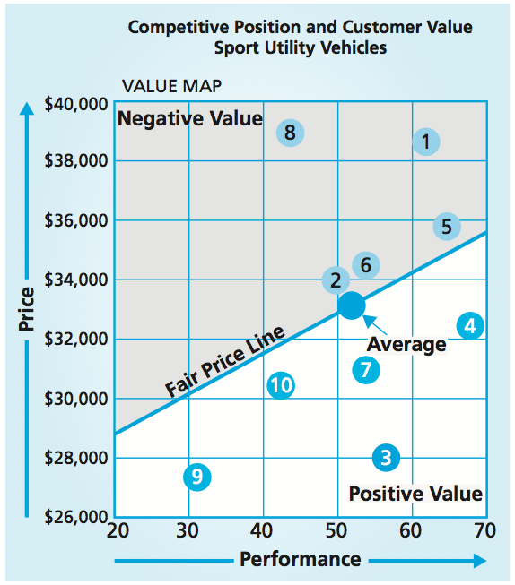
Competitive Position & Sources of Advantage
MBM6
Chapter 6
Chapter 6
Understanding Competitive Advantage, Customer Value, and Profitability
Discovering Sources of Competitive Advantage
Assessing Industry Attractiveness and Forces
Value, rather than cost, must be used in analyzing competitive position.
Copyright Roger J. Best, 2012

Slide 2
Competitive Position & Sources of Advantage
MBM6
Chapter 6
Understanding Competitive Advantage, Customer Value, and Profitability
In this section we will look at how a competitive advantage results in some level of superior customer value based on a customer’s preference for performance benefits, the cost of the purchase, and the ease of the purchase.
Copyright Roger J. Best, 2012

Slide 3
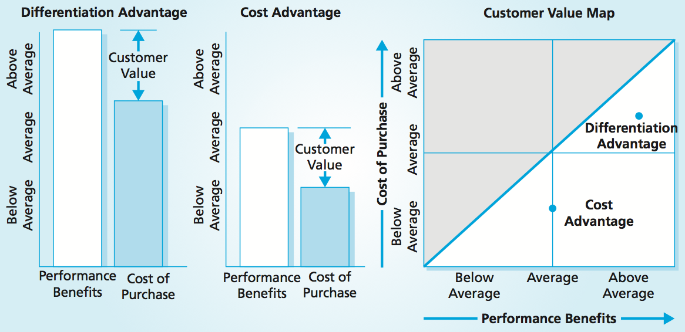
Competitive Advantage, Customer Value, & Profitability
MBM6
Chapter 6
A competitive advantage results in some level of superior customer value based on a customer’s preference for performance benefits, the cost of the purchase, and the ease of the purchase.
Copyright Roger J. Best, 2012

Slide 4
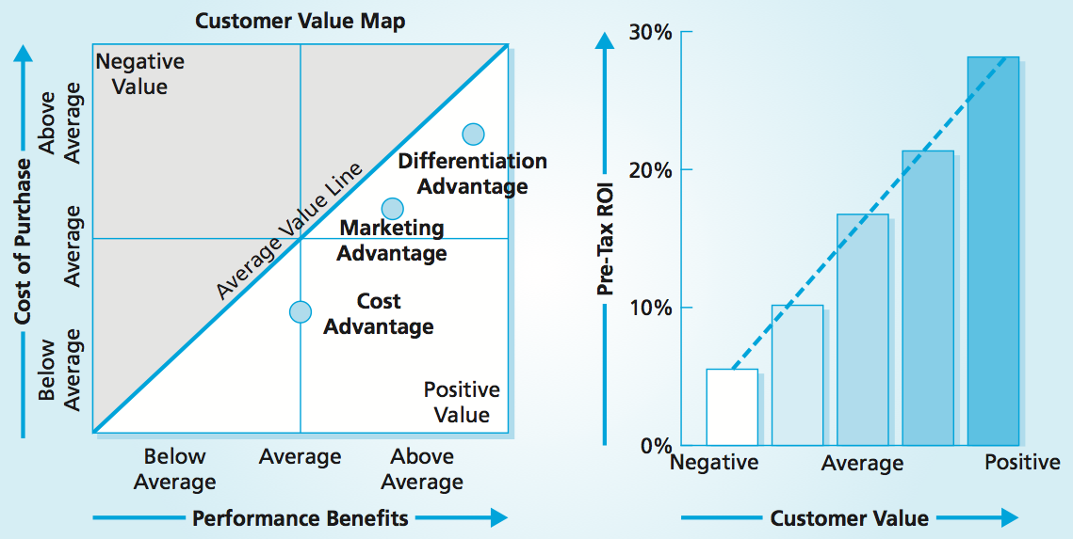
Competitive Advantage, Customer Value, & Profitability
MBM6
Chapter 6
Superior customer value results in superior profits
To achieve above-average profits, a business has to develop some source of competitive advantage that provides target customers with positive customer value.
Copyright Roger J. Best, 2012

Slide 5
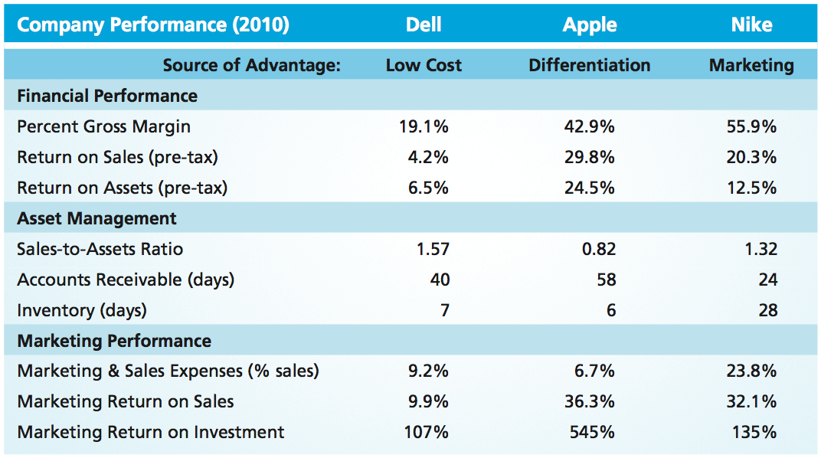
Sources of Advantage & Performance
MBM6
Chapter 6
Compare and contrast the three companies above in terms of their sources of competitive advantage and the relative impact on their financial performance
Copyright Roger J. Best, 2012

Slide 6
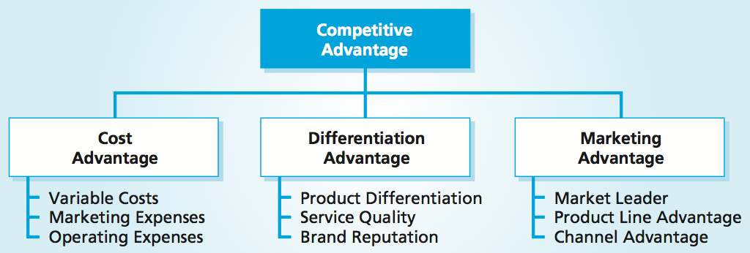


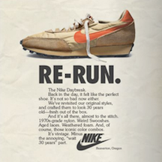
Sources of Competitive Advantage
MBM6
Chapter 6
Copyright Roger J. Best, 2012

Slide 7
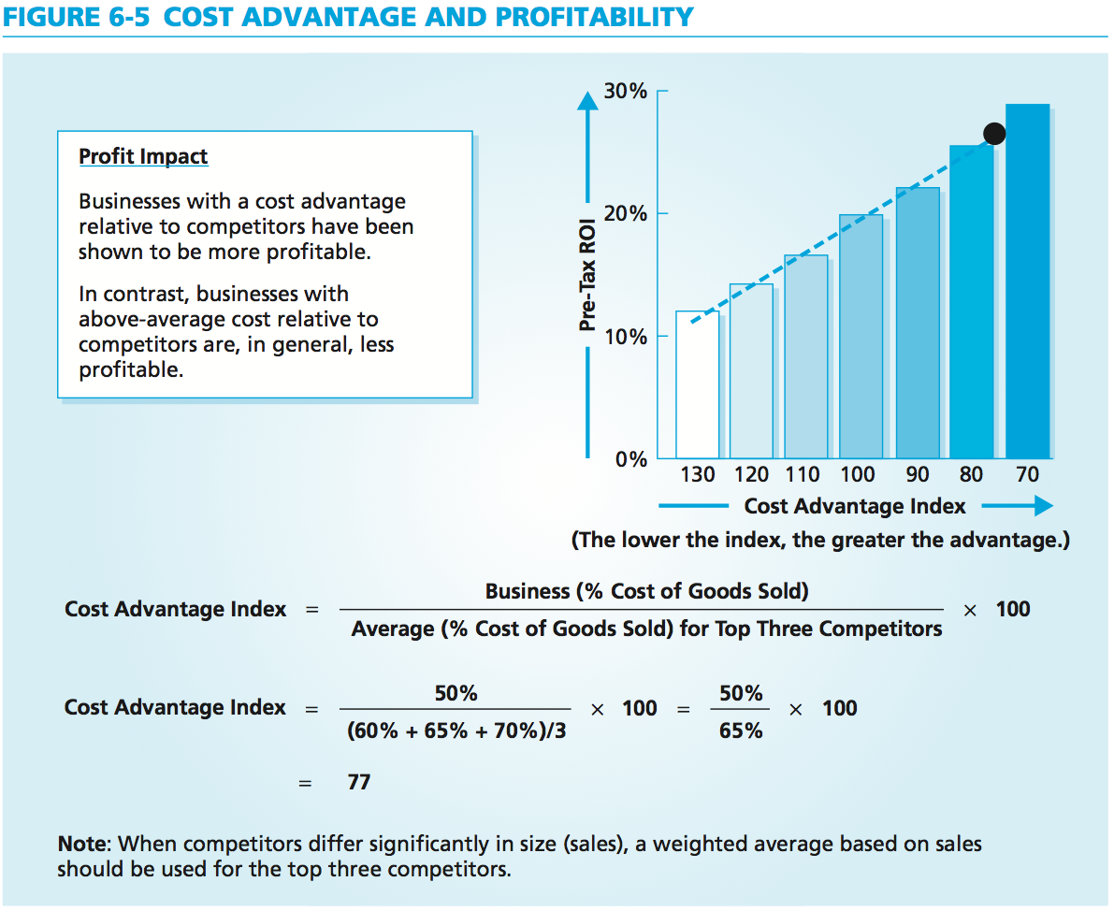
Cost Advantage and Profitability
MBM6
Chapter 6
Each type of cost advantage can be achieved in several ways.
A cost advantage relative to competition contributes to higher levels of profitability.
Copyright Roger J. Best, 2012

Slide 8
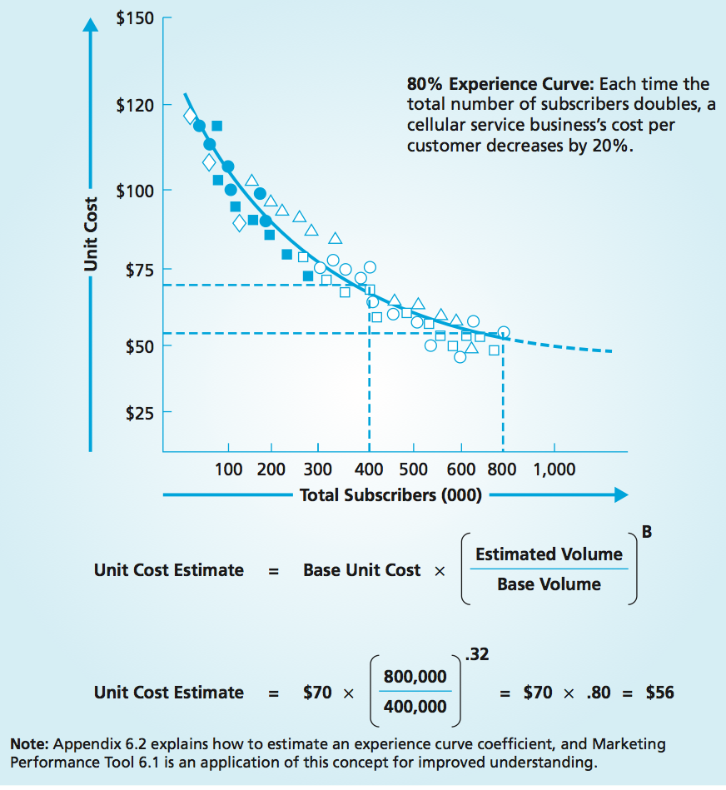
Marketing Performance Tool 6.1
Unit Cost & Experience Curve
MBM6
Chapter 6
As volume increases, the cost per unit generally decreases.
Scale Effect: larger unit volume allows for production and purchasing economies that lower the per-unit manufacturing cost of a product.
Scope Effect: a business can lower the average unit cost of all products by adding products that have similar manufacturing processes and that are made of the same materials as its other products.
Learning Effects: each unit produced provides additional learning and the opportunity to build the next unit more efficiently.
Copyright Roger J. Best, 2012

Slide 9
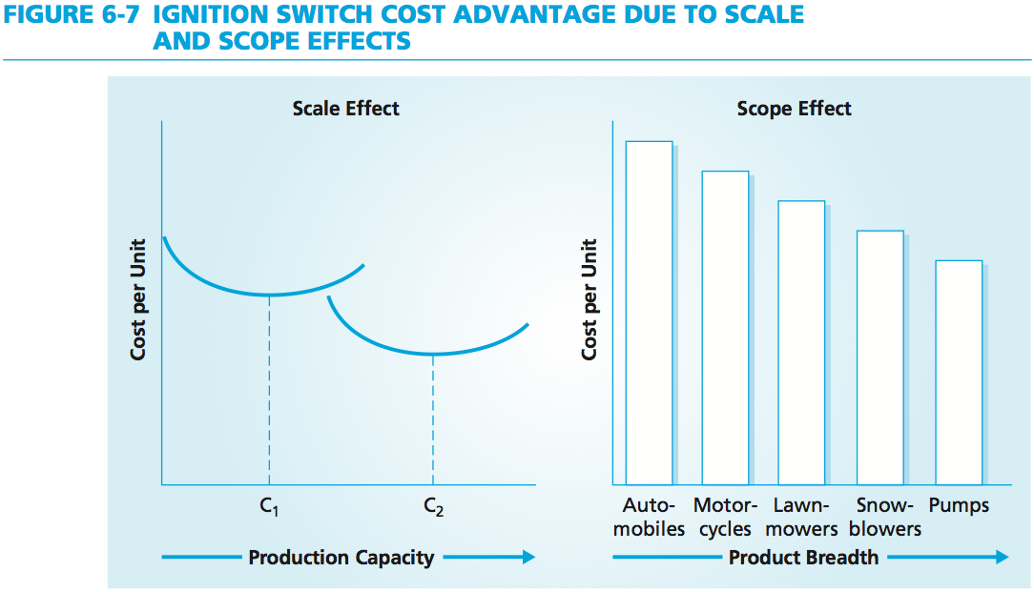
Scale and Scope Cost Advantages
MBM6
Chapter 6
For Honda, the cost of ignition switches is lower than for some other manufacturers because the same ignition switch components are used in cars, motorcycles, lawn mowers, all-terrain vehicles, snow blowers, snowmobiles, jet skis, and generators.
Copyright Roger J. Best, 2012

Slide 10
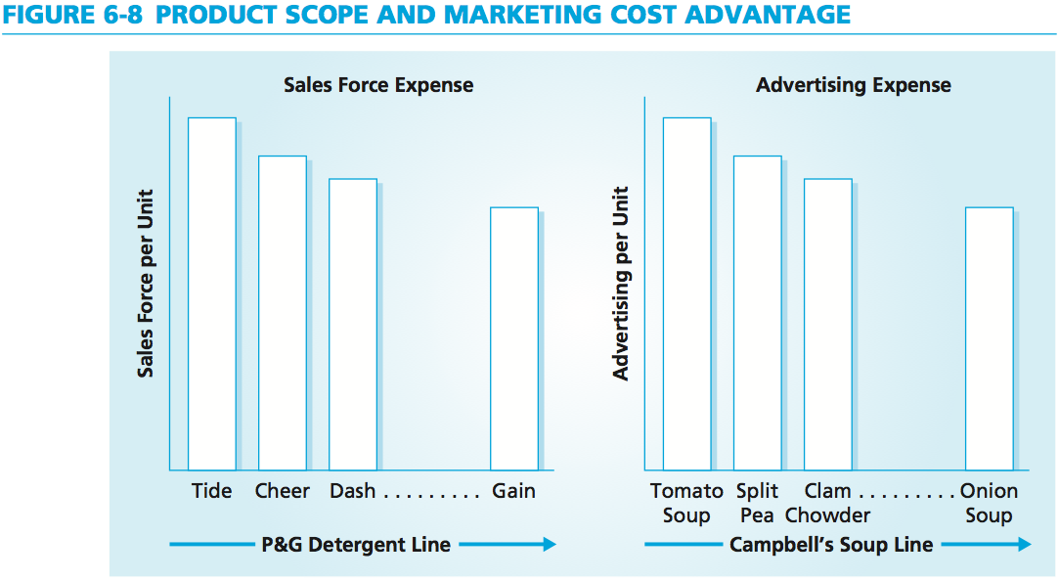
Product Scope and Marketing Cost Advantage
MBM6
Chapter 6
Procter & Gamble’s sales force expense per pound of detergent sold should decrease as it adds more brands of detergent to its product line.
Each time a soup is advertised, the ad reinforces top-of-the-mind awareness of Campbell’s Soup brand and other soups in the product line.
Copyright Roger J. Best, 2012

Slide 11
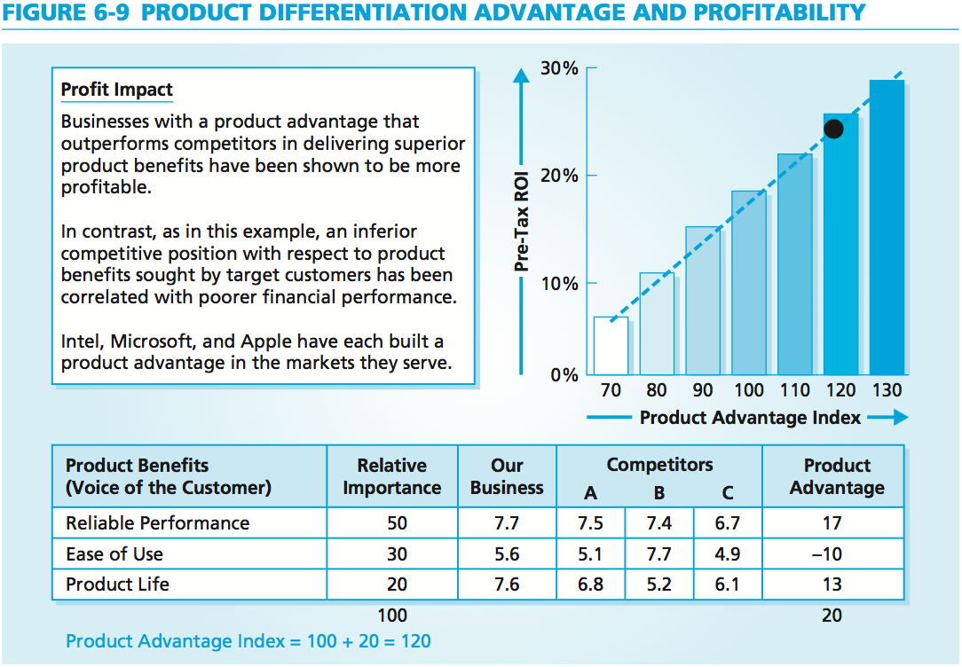

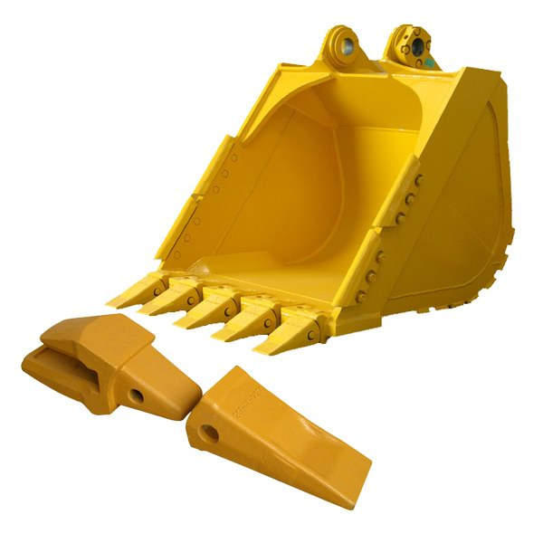

Marketing Performance Tool 6.2
Product Differentiation Advantage
MBM6
Chapter 6
A product’s durability, reliability, performance, features, appearance, and conformance to a specific application each have potential to be a differentiation advantage.
Copyright Roger J. Best, 2012
Notes:
ESCO Corporation, for example, is a manufacturer of earth-moving equipment parts that are used in very demanding mining and construction applications. The company has developed a differentiation advantage in the wear life of its products due to proprietary steel chemistry and product design. Its products last longer and are less likely to break than are the products of its competitors. Both of these product benefits save the customer money even when the products are sold at a higher price. Overall, businesses with a relative advantage in product quality produce higher levels of profitability, as illustrated in Figure 6-9.

Slide 12
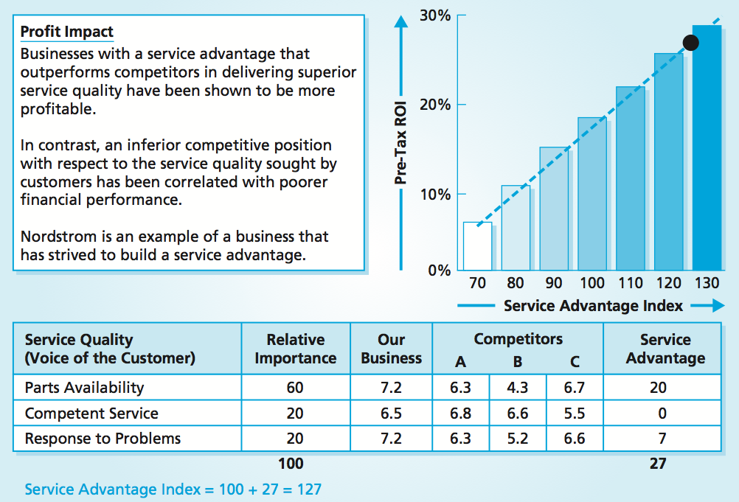

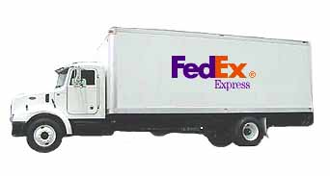

Service Differentiation Advantage
MBM6
Chapter 6
By tracking its service performance each day, FedEx is able to create greater overall customer satisfaction with fewer errors, lower costs, and greater profits for shareholders.
Copyright Roger J. Best, 2012
Notes:
FedEx tracks its performance on 10 service quality indicators (each weighted by the “customer pain” that a failure creates). This service quality index is carefully monitored each day to help FedEx maintain a service quality advantage. As its service quality index improves, customer satisfaction improves and the overall cost per package decreases. By tracking its service performance each day, FedEx is able to create greater overall customer satisfaction with fewer errors, lower costs, and greater profits for shareholders. As Figure 6-10 shows, businesses with a service advantage produce higher levels of profitability.

Slide 13
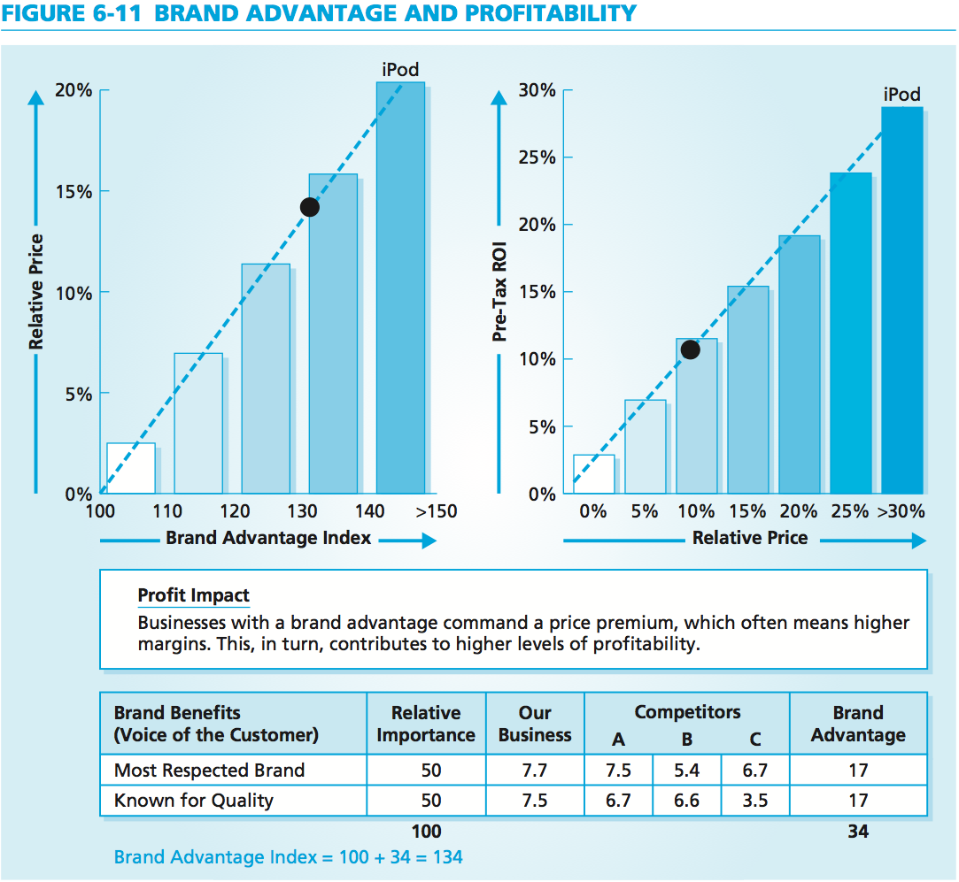




Brand Advantage & Profitability
MBM6
Chapter 6
The stature of brand names adds a dimension of appeal that is an important customer benefit for many less price-sensitive, more image-conscious consumers.
Copyright Roger J. Best, 2012
Notes:
Although competing watchmakers may match the quality of a Rolex watch, they cannot easily match Rolex’s brand reputation advantage. Brands such as Chanel, Nikon, and Perrier also have built reputations that provide a source of competitive advantage in their ability to attract target customers. For these companies, the stature of their brand names adds a dimension of appeal that is an important customer benefit for many less price-sensitive, more image-conscious consumers.

Slide 14
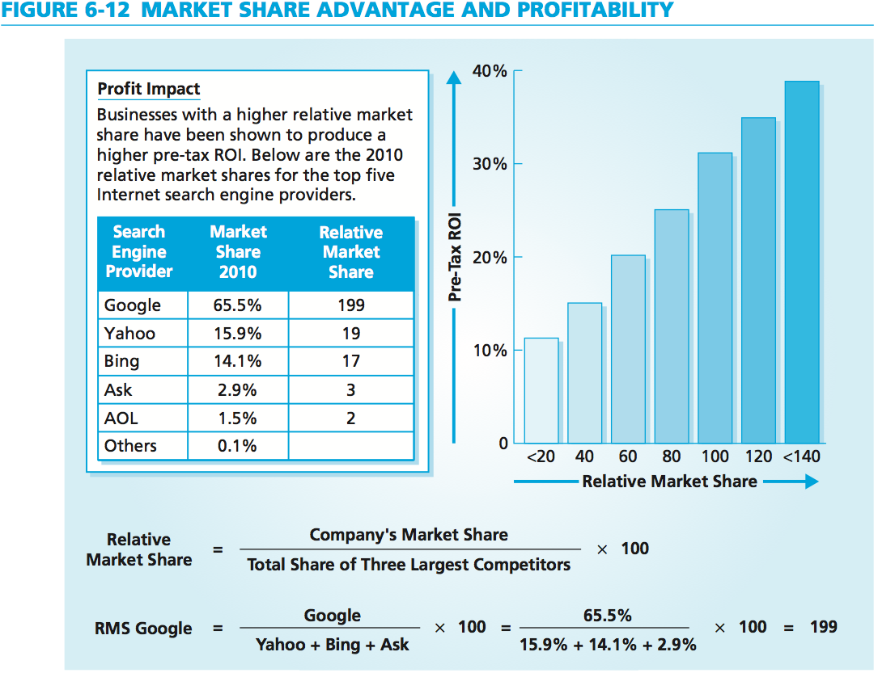




Marketing Performance Tool 6.3
Market Share Advantage & Profits
MBM6
Chapter 6
The more dominant the share leader is with regard to market share compared with its top three competitors, the greater are the share leader’s profits.
Copyright Roger J. Best, 2012
Notes:
In this example, Google is the share leader among search engines and has a relative market share of 199. Yahoo, number two in market share, has a relative market share of 19, and number three AOL has a relative market share of 2. For this industry, relative market share partially explains large differences in company profitability. Market leaders have well-known, trusted brands; many variations in their product lines; and highly effective distribution systems.

Slide 15
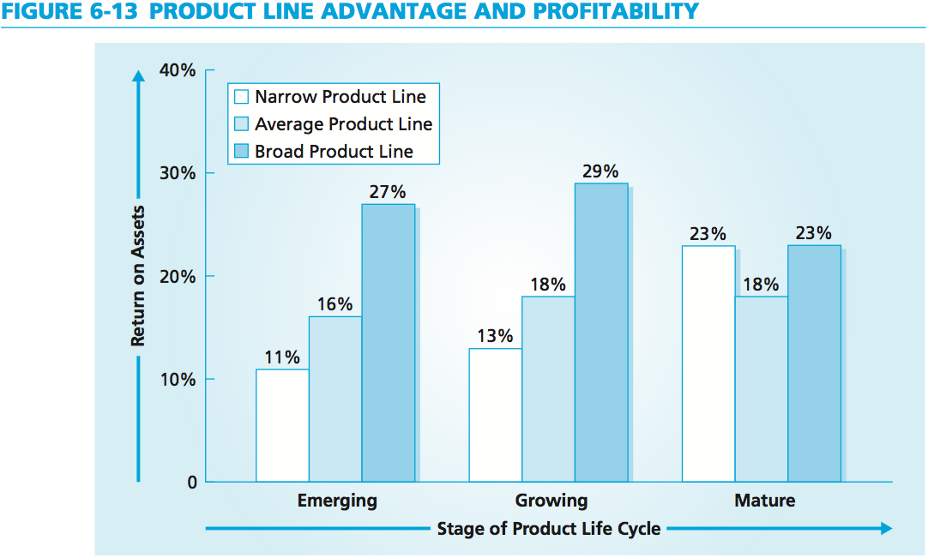




Marketing Performance Tool 6.3
Product Line Advantage
MBM6
Chapter 6
Microbrew Segment
Import Position
A broad product line gives a business more prospective customers and the potential to sell more to each customer—translating into more sales and higher levels of profitability.
Low-Cal, Low-Carb
Copyright Roger J. Best, 2012

Slide 16

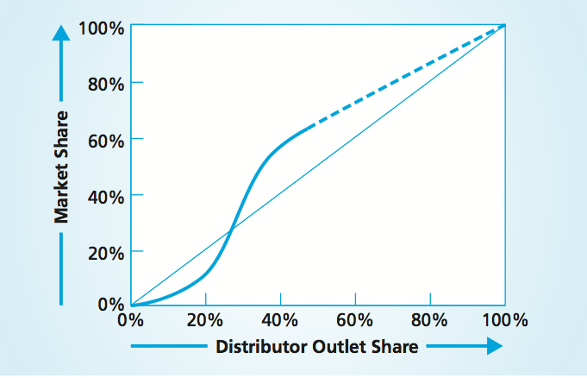

Marketing Performance Tool 6.3
Channel Advantage
MBM6
Chapter 6
A business that has exclusive access to distributors can control channels in a given market and, to some degree, can control market access.
Copyright Roger J. Best, 2012

Slide 17
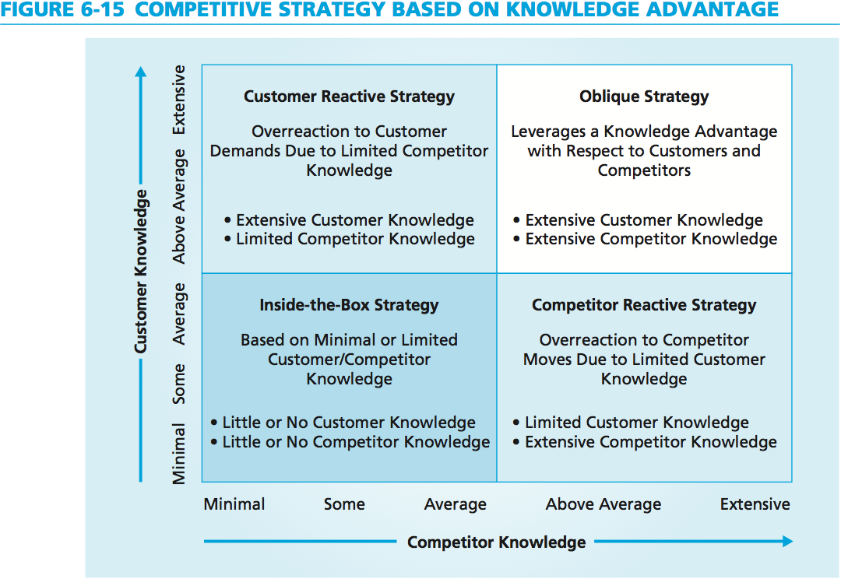
Competitive Strategy Based on Knowledge Advantage
MBM6
Chapter 6
A business with excellent customer knowledge but limited competitor knowledge will likely overreact to customer demands.
Copyright Roger J. Best, 2012

Slide 18
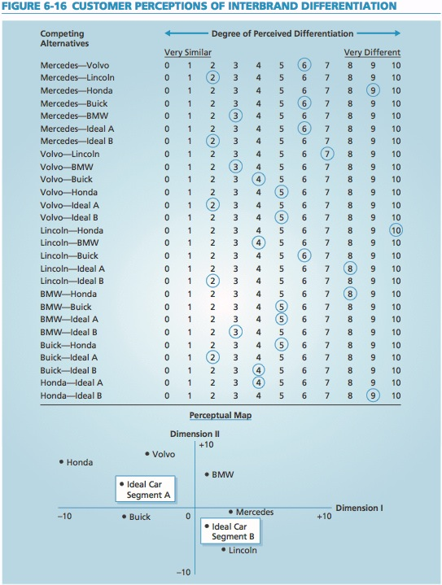
Customer Perceptions of Interbrand Differentiation
MBM6
Chapter 6
A business can use a variety of multidimensional scaling programs to create a perceptual map, such as the one shown above. In this example, interbrand differentiation is graphed in two dimensions.
Copyright Roger J. Best, 2012

Slide 19
Competitive Position & Sources of Advantage
MBM6
Chapter 6
Discovering Sources of Competitive Advantage
In this section we will look at how a competitive advantage requires that (1) the area of relative advantage be meaningful to target customers, and (2) the relative advantage be sustainable (not easily copied by competitors).
Copyright Roger J. Best, 2012

Slide 20
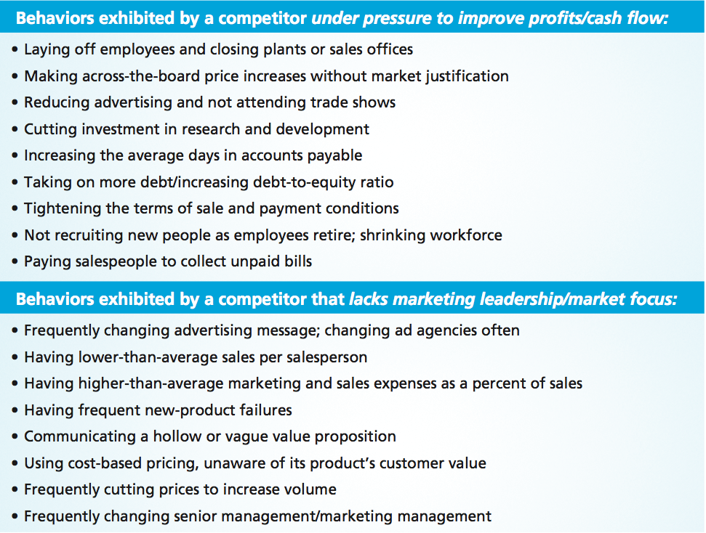
Knowing When a Competitor is in Trouble
MBM6
Chapter 6
Copyright Roger J. Best, 2012

Slide 21
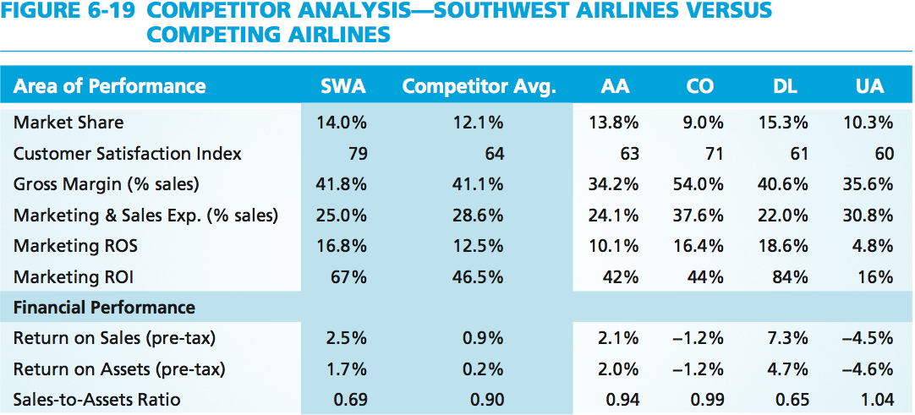

Competitor Analysis
MBM6
Chapter 6
Copyright Roger J. Best, 2012

Slide 22
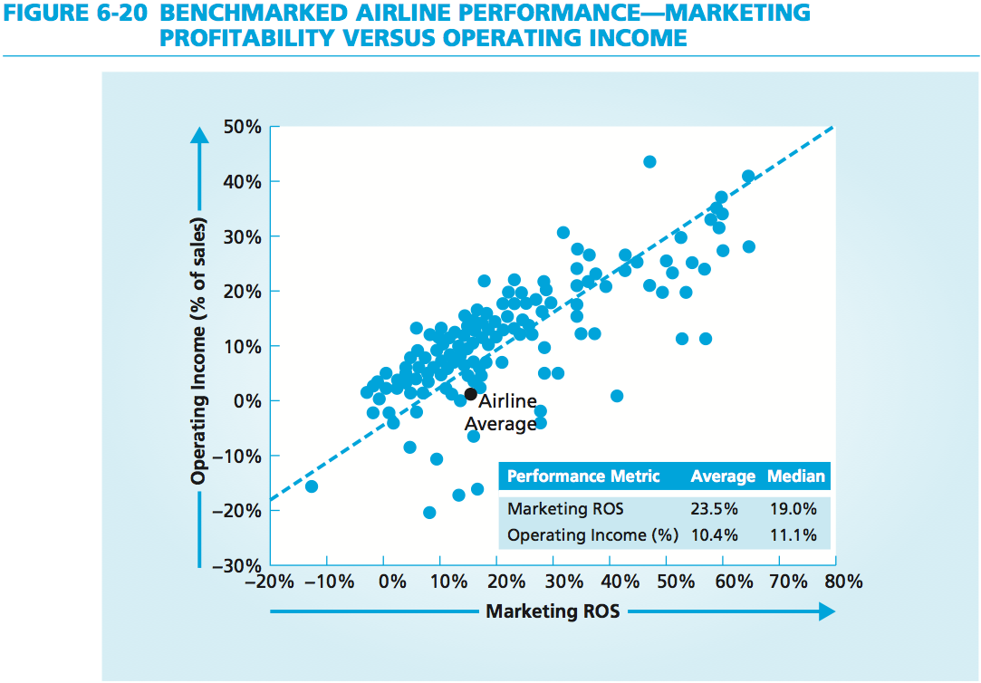

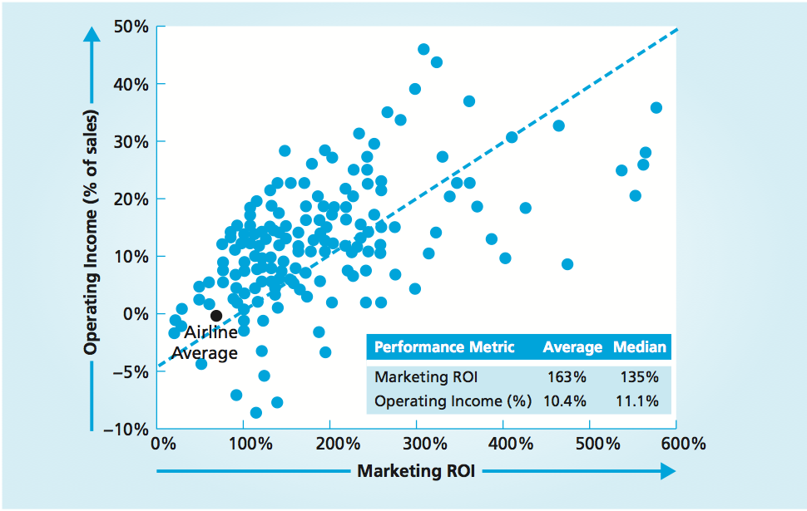
Marketing Profitability vs. Operating Income
MBM6
Chapter 6
The averages for the five airlines are well below the averages and median performances for operating income, marketing return on sales, and marketing return on investment for the 200 Fortune 500 companies.
Copyright Roger J. Best, 2012

Slide 23
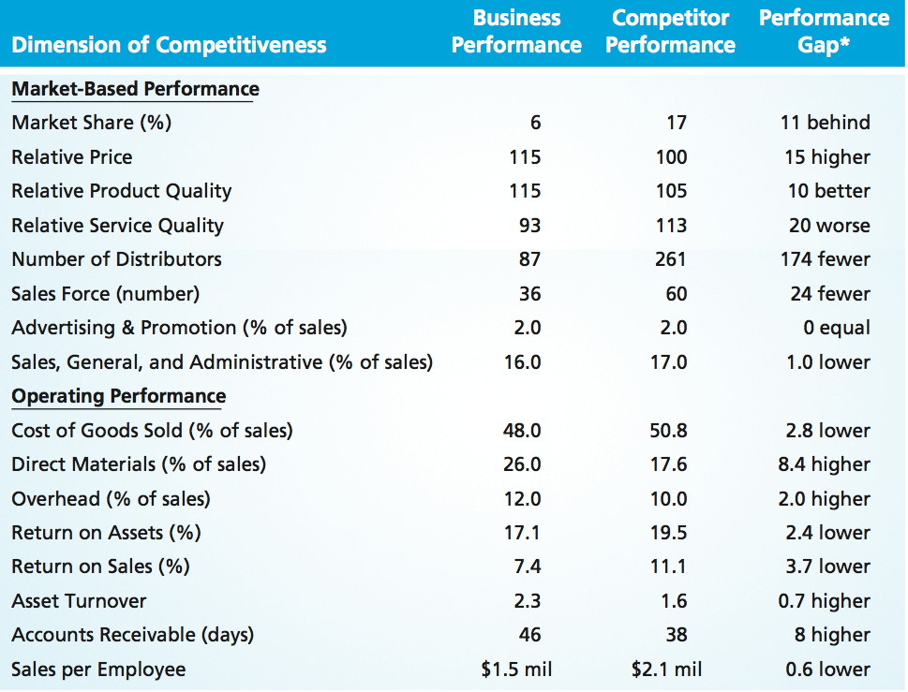
Competitor Analysis
MBM6
Chapter 6
This competitor analysis is broken down into two categories: market-based performance and operating performance.
Copyright Roger J. Best, 2012

Slide 24
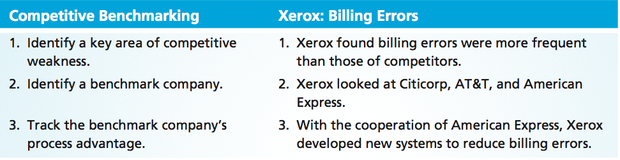


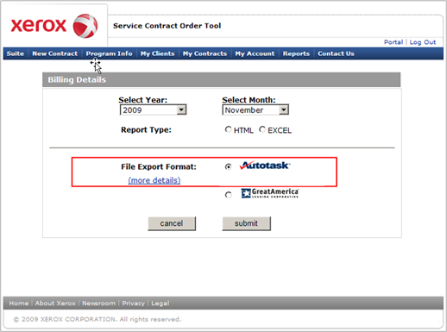
Competitive Benchmarking
MBM6
Chapter 6
How could the airlines leverage competitive benchmarking to learn and apply best practices from other industries?
Copyright Roger J. Best, 2012

Slide 25
Competitive Position & Sources of Advantage
MBM6
Chapter 6
Assessing Industry Attractiveness and Forces
In the final section we will briefly look at how we need to engage in a detailed analysis of competitors to understand the degree to which a business has a position of competitive advantage.
Copyright Roger J. Best, 2012

Slide 26
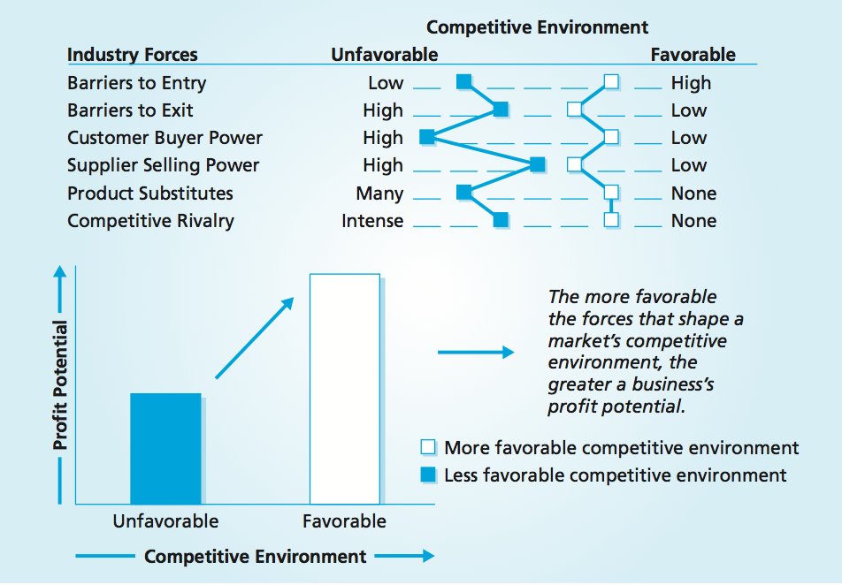
Marketing Performance Tool 6.4
Industry Forces and Profit Potential
MBM6
Chapter 6
Copyright Roger J. Best, 2012

Slide 27
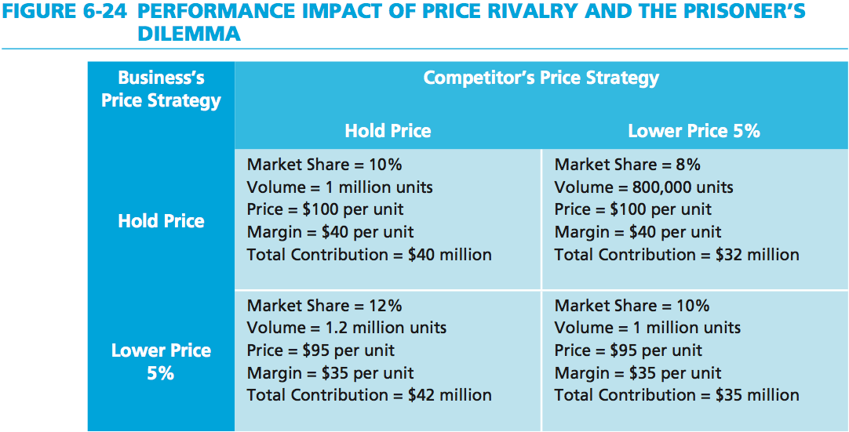
Price Rivalry and the Prisoner’s Dilemma
MBM6
Chapter 6
What is the worst potential outcome for the situation presented above?
Copyright Roger J. Best, 2012

